Slide 1
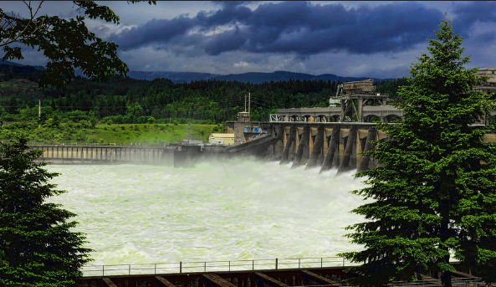
Will the Snake River Dams
Be Breached?

Slide 2
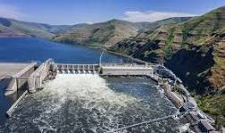
Disclaimer: Nothing I say today should be construed as in any way representative of opinions or policies of the Montana Public Service Commission

Slide 3
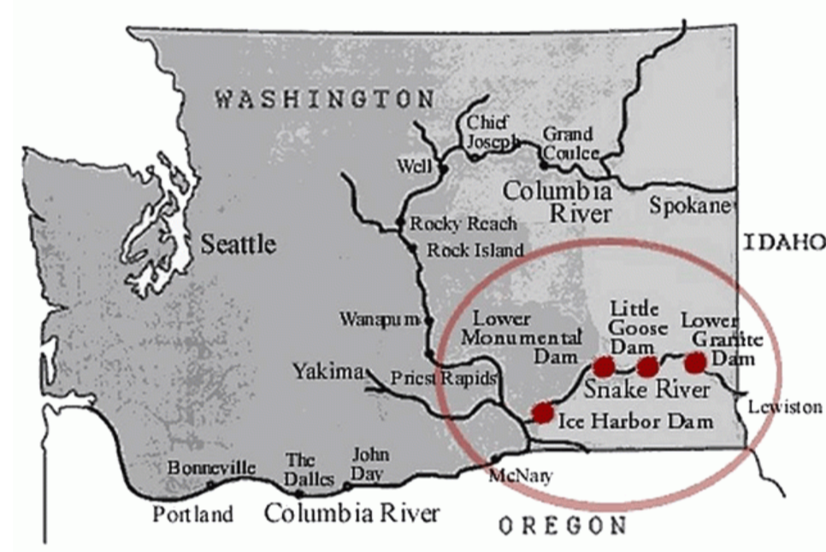
WASHINGTON’S LOWER SNAKE RIVER DAMS

Slide 4
WASHINGTON’S LOWER SNAKE RIVER DAMS
Will they be breached?
To those who think that would never happen, study the process that led to the
Klamath Dam breach completed Jan. 2024

Slide 5
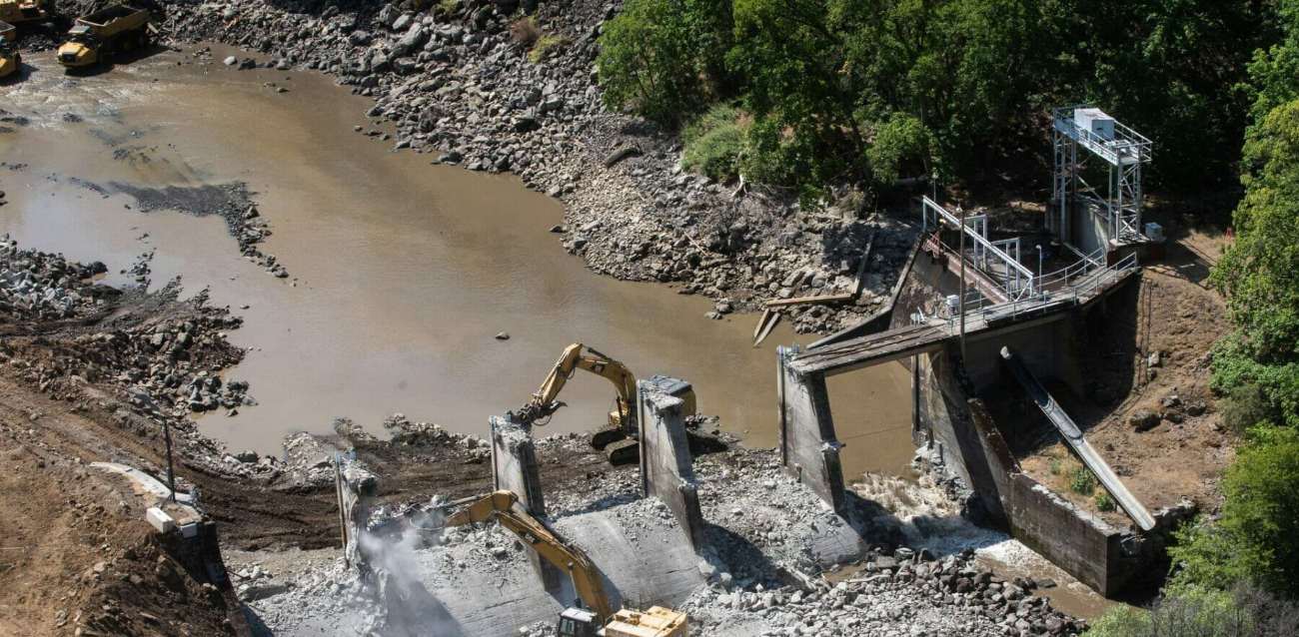

Slide 6
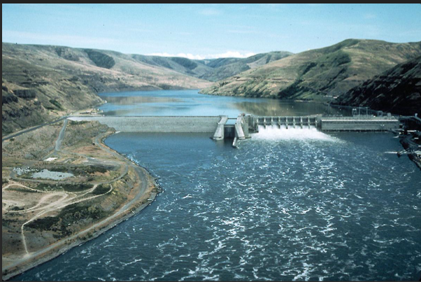
Memorandum of Understanding
Related to Columbia Basin Restoration Initiative
signed 12/14/23 by
Oregon and Washington Governors
five federal agencies
four tribes
Un-invited: Montana, Idaho, and six other tribes
Notes:
The federal agencies include U.S. Army Corps of Engineers, Bureau of Reclamation, BPA, National Marine Fisheries Serviced, and the U.S. Fish and Wildlife Service

Slide 7
Columbia Basin Restoration Initiative
92 pages including tables, attachments,
and appendices …
A proposal to the Biden Administration
from the “Six Sovereigns”

Slide 8
Memorandum of Understanding
Signed 12/14/23
19 pages in response to CBRI proposal signed by
4 tribal leaders
Oregon and Washington state representatives
9 conservation group representatives
5 Federal representatives

Slide 9
CBRI OBJECTIVES
of PROPOSAL by the Six Sovereigns
“Objective 1: “Develop and advance an urgent, comprehensive strategy to (a) restore salmon and steelhead to “healthy and abundant levels” consistent with NOAA’s Columbia Basin Partnership Task Force (CBP) and Rebuilding reports; and (b) complete the actions and investments necessary to secure continuity of services associated with Lower Snake River (LSR) restoration prior to LSR dam breaching.”

Slide 10
CBRI OBJECTIVES
“Objective 2: Ensure that all native species, regardless of listing status, are considered in the comprehensive strategy in a way that improves ecosystem function in the Columbia River and its tributaries”
“Objective 3: Ensure interim fish measures are adequate
to minimize additional generational decline of fish populations.

Slide 11
CBRI OBJECTIVES
“Objective 4: Invest in and support communities and economic sectors (e.g., energy, transportation, agriculture, and recreation) in a manner that is consistent with meeting decarbonization goals and mandates and integration of renewables, delivers “affordable and clean power”, improves resiliency and adaptability to climate change and supports “the many resilience needs of stakeholders across the region”, and “[honors] commitments to Tribal Nations”.

Slide 12
CBRI OBJECTIVES
“Objective 5: Secure necessary regulatory compliance, authorizations, and appropriations for implementation of the strategy with an urgency reflecting the needs of the fish.”
“Objective 6: Ensure that the strategy and associated federal actions
“honor Federal commitments to Tribal Nations” and address past and
ongoing inequities related to Columbia Basin development to reflect
and uphold federal Treaty and trust responsibilities to
Columbia Basin tribes.”

Slide 13
APPENDIX A
DOE PROGRAM PROPOSAL:
ADVANCING TRIBAL ENERGY SOVEREIGNTY
in the PACIFIC NORTHWEST
1. Tribal Energy Sovereignty Resource Planning Process
2. Tribal Energy Sovereignty Project Development

Slide 14
APPENDIX A: Examples of FUNDING AVAILABLE
Grid resilience grant funding up to $459 million annually
National Clean Investment Fund $14 billion
Efficient Electric Appliance Rebates $225 million
Energy Improvement in Rural and Remote Areas $1 billion
$20 billion DOE Tribal Energy Loan Guarantee Program

Slide 15
APPENDIX A: Examples of FUNDING AVAILABLE
Grid resilience grant funding up to $459 million annually
Energy Efficiency and Conservation Block Grants $5.5 million
Tribal Electrification Program received $145 million via IRA
BPA appropriated $300 million for fish restoration 09/27/23
BPA gave $900 million for endangered salmon by 2008

Slide 16
Memorandum of Understanding
Signed 12/14/23
Bonneville Power Administration
was one of the Federal Signees
A representative of BPA pointed out that the MOU is not identical to the CBRI

Slide 17
Memorandum of Understanding
16 WHEREAS
11 NOW THEREFOREs
“2. USC Commitments in Support of the” CBRI

Slide 18
MOU THEREFORE #2
“2. USG Commitments in Support of the” CBRI
the outcome of the environmental compliance and
2.1…The Parties recognize that the USG Commitments and
actions identified in this MOU could change depending on
associated Federal agency decision-making processes or
(2) congressional action to authorize and fund the
breach of the four lower Snake River dams

Slide 19
Bonneville Power Administration (BPA)
Four-State
Public Utility Commission Meeting
Portland, Oregon January 11, 2024

Slide 20
Commissioner Round Table Discussion
Focus of discussion was what
BPA Chief Executive Officer John Hairston proclaimed
“the Fish Agreement”
AKA Columbia Basin Salmon Agreement
AKA Secret Agreement to Breach Snake River Dams
Memorandum of Understanding
in response to CBRI Proposal

Slide 21
OBJECTIONS by PSC-PUC Commissioners
to CBRI were of two categories
1. The illegality, immorality and lack of ethics
of not involving the other eight sovereigns
--Multiple lawsuits will or have been filed
Notes:
If not filed already

Slide 22
The 08/4/2022 Joint Motion
Related to CBRI
The federal government “committed to developing strategies through inclusive regional collaborative processes…”
Then left out multiple tribes
and the states of Montana and Idaho
Notes:
If not filed already

Slide 23
Category #2
of OBJECTIONS by commissioners to CBRI
questionable premises of the document itself

Slide 24
Questionable Premise #1:
Honoring 1855 Treaties
between the U.S. and Tribes
gives Tribes complete control
over these rivers and dams

Slide 25
MULTIPLE 1855 TREATIES U.S. and TRIBES
VAGUELY REFERENCED in CBRI - MOU
LANGUAGE SIMILAR TO IDENTICAL
IN TREATIES with
the four tribes that signed CBRI

Slide 26
MULTIPLE 1855 TREATIES U.S. and TRIBES
ABSENCE of DELINEATION or CLEAR
DEFINITION of WATER RIGHTS
WOULD IT WITHSTAND
UNBIASED LEGAL REVIEW ?
Notes:
The tribe promises to be friendly with all citizens and not harm the property of citizens
The tribe members are not allowed to drink alcohol

Slide 27
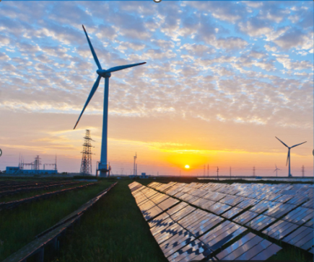
Highly Questionable Premise #2
Megawatts from Hydropower can be
replaced by solar and wind
Notes:
According to the DOE hydropower primer..READ..Dams block fish from moving along their natural pathways between feeding and spawning grounds, causing interruptions in their life cycles that limit their abilities to reproduce.

Slide 28
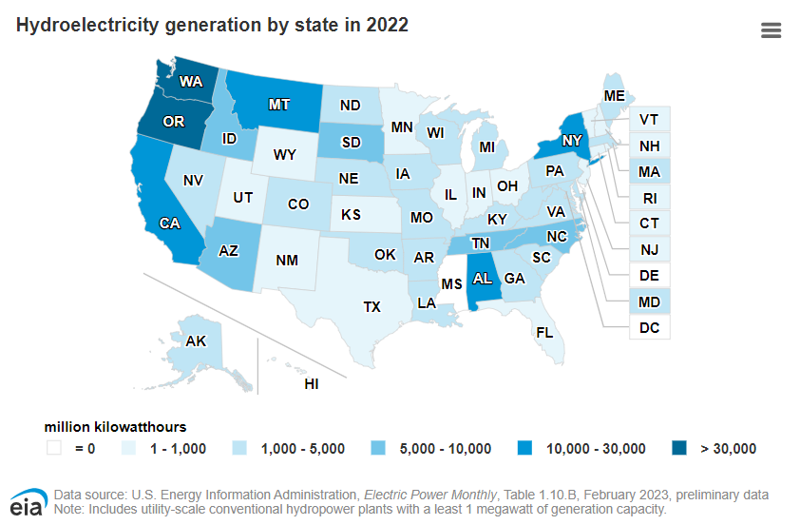
Clean, Green, renewable HYDROELECTRIC POWER is our STRONG SUIT

Slide 29
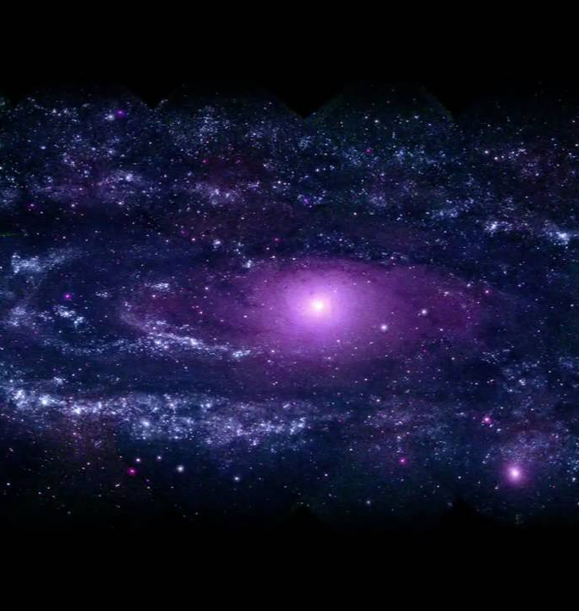
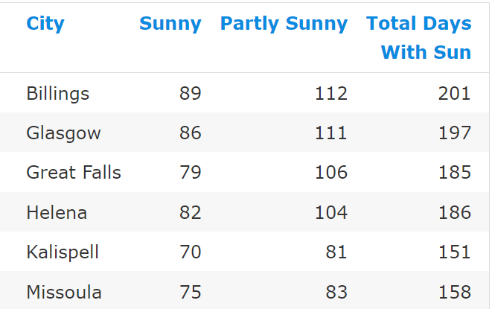
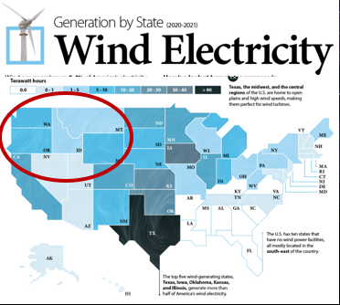
Renewable Power
in the Pacific Northwest:
IS NOT SOLAR
NOT WIND
Hydroelectric is > 75%
of Renewable Energy

Slide 30
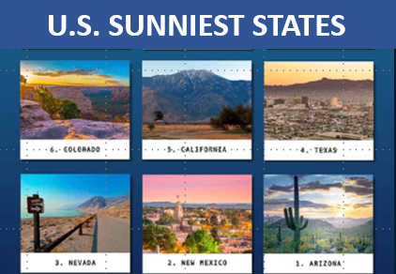
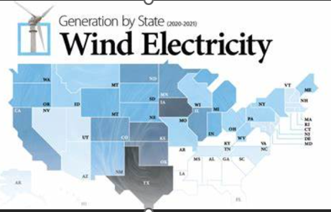
Take a look at the sunny, windy
California
Notes:
According to the DOE hydropower primer..READ..Dams block fish from moving along their natural pathways between feeding and spawning grounds, causing interruptions in their life cycles that limit their abilities to reproduce.

Slide 31
2021
California’s Portfolio
For
Energy Generation
And
Energy Importation
Notes:
What I’m showing here is California’s 2021..In the next slide, I’ll give you a slightly larger view

Slide 32
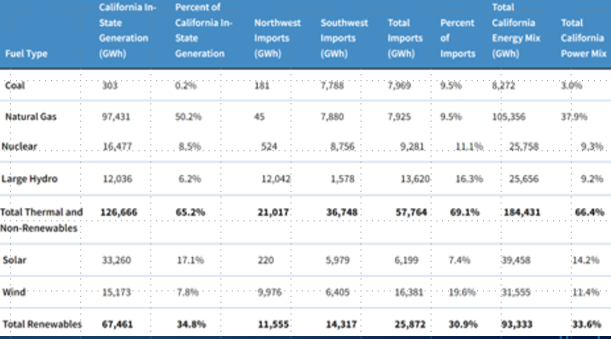
Notes:
I highlighted some columns and rows to draw your attention to them…In the interest of time to make my primary points for this slide…Natural gas is by far and away the single largest contributor to California power generation in the state, far above all others. And notice that 2/3 of their power came from non-renewables in 2021…Included in that is that through 2021, California called large hydroelectric facilities non-renewable. Their category of total renewables only contributed a third as you can see

Slide 33
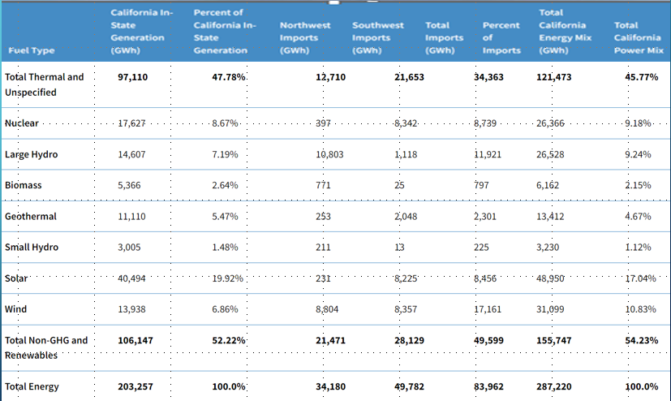
2 0 2 2

Slide 34
40 + years of using solar and wind power in California
40 + years of $$ subsidies for solar and wind projects
SOLAR & WIND
PROVIDE < 1/3 of California electricity
NATURAL GAS,
a HYDROCARBON
is California’s #1 electricity source

Slide 35
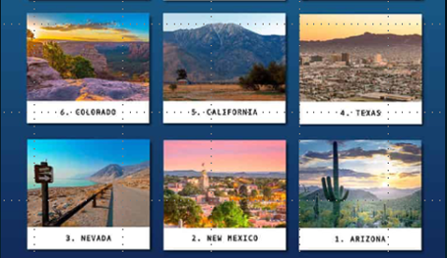
U.S. SUNNIEST STATES
SOLAR AND WIND provide less than 28% of electricity
in sunny, windy California
And it is thought solar and wind can replace hydropower
Megawatt for Megawatt
in the Pacific Northwest ?

Slide 36
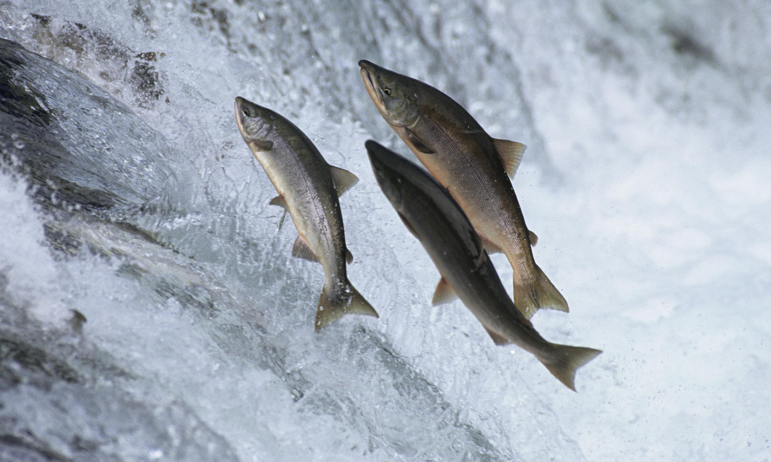
IMPACT of these dams on FISH HABITAT is a LEGITIMATE USE of hundreds of MILLIONS MORE TAXPAYER DOLLARS
Highly Questionable Premise #3:
Let’s look at the evidence
Notes:
According to the DOE hydropower primer..READ..Dams block fish from moving along their natural pathways between feeding and spawning grounds, causing interruptions in their life cycles that limit their abilities to reproduce.

Slide 37
By 2008, BPA put in $900 million into fish habitat restoration
Outcome ?
Notes:
According to the DOE hydropower primer..READ..Dams block fish from moving along their natural pathways between feeding and spawning grounds, causing interruptions in their life cycles that limit their abilities to reproduce.

Slide 38
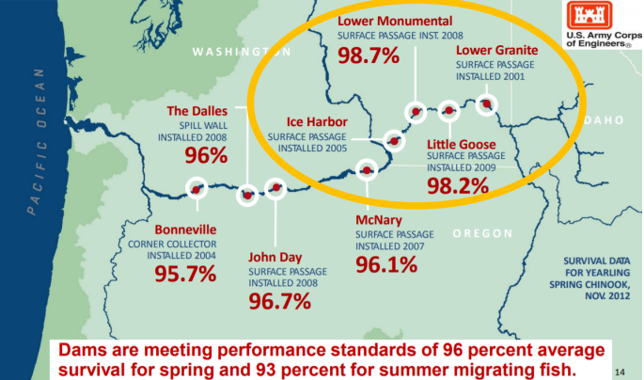
BPA Integrated Program Review, Fish and Wildlife, July 2018, page 14

Slide 39
Delving into the dams
Federal legislative tour shows staffers how critical lower Snake River dams are to the region
October 2023 issue of Wheat Life
“Lower Granite Dam’s retrofitted fish passage
technology…and… counting fish returns…
Lower Granite Dam has hit 98% fish passage.”

Slide 40
CBRI OBJECTIVES
“Objective 3:
Ensure interim fish measures are adequate to minimize additional generational decline of fish populations.
Notes:
Parce words

Slide 41
Oregon State University Study 7/2023
Nine billion spent for improving fish habitat
Conclusion: While hatchery-reared salmon
numbers have increased, no increase
in wild, naturally spawning salmon
Notes:
According to the DOE hydropower primer..READ..Dams block fish from moving along their natural pathways between feeding and spawning grounds, causing interruptions in their life cycles that limit their abilities to reproduce.

Slide 42
CBRI OBJECTIVES
“Objective 2:
Ensure that all native species, regardless of listing status, are considered in the comprehensive strategy in a way that improves ecosystem function in the Columbia River and its tributaries”
Notes:
Was this another project meant to fail? Always a way of bringing in an alleged species, they can always hold up the …my question as I look at this …what is the real objective…to shut off our power or to really help the ecology…Do you really thing any of this is reasonable? Obtainable or an unobtainable goal so we can breach the dams…designed to put the power out…what happens if we have a 5-10 day outage…what would my patients do? How many would die? How many irretrievable…zero degrees out forcedair heaters…no electricity…plenty of gas…how…I’m only one…200 or 300 doctors …Is it going to be you…your ….babies in incubators, patients on ventilators…without electricity…getting out of hand…ignoring the fact it’s getting out of hand…I’m a doctor…don’w want to 25 years devoted to help people live through catastrophes, …this is what doctors do…because someone can name a difference species of fish, my patients are going to die and that concerns me…that’s why we don’t have…we have people answerable to their communities…come in from the community that …electricity, can’t pump gas into the cars…to shut ins

Slide 43
COLUMBIA BASIN RESTORATION INITIATIVE
BILLIONS MORE TAX DOLLARS GOING FOR FISH RECOVERY
HUNDREDS of THOUSANDS of CITIZENS
at RISK for LOSING POWER, IRRIGATION and NAVIGATION
OPENING the DOOR for MORE LAWSUITS

Slide 44
COLUMBIA BASIN RESTORATION INITIATIVE
BASED on VAGUE LANGUAGE
ABOUT FISHING RIGHTS
in 1855 TREATIES

Slide 45
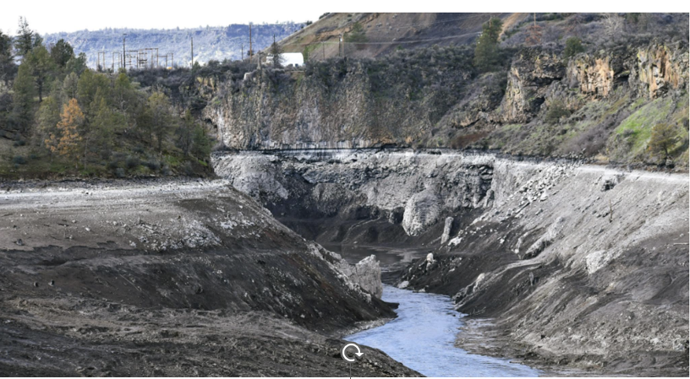
“Ironically, dam removal proponents claimed the project would help salmon,
but now the Klamath River is being polluted with millions of cubic yards of
decomposed algae, organic deposition, chemicals, and fine silt that has built
up behind the dams. Dead steelhead trout and other species are floating to
the banks. Any salmon spawning beds in the Klamath River were
undoubtedly destroyed. At press time, conditions in the Klamath River were
not likely survivable for the salmon juveniles that were beginning to emerge
From the tributary rivers and creeks on their way to the ocean.”

Slide 47
COLUMBIA BASIN RESTORATION INITIATIVE
WHY are federal agencies and
two state governments using
your tax dollars to place you and
hundreds of thousands of your
neighbors at risk?
Notes:
These regulators and policy makers are disassociated from the impacted communities; My clinic uses natural gas for heating that requires electricity to circulate the heat. That electricity is provided by Flathead Electric Coop and Bonneville Power Administration. So to keep the lights on in my clinic, and keep the heat on in winter and the air conditioning in summer, my patients rely on BPA to provide the electricity required for their care. Our local hospital likewise…when the power goes out, if this initiative perseveres, then the petrol for the hospital generator runs dry…People will die within a short period of time. Are these practical matters being considered?

Slide 57
WASHINGTON’S LOWER SNAKE RIVER DAMS in the news LATELY POSSIBLE CLOSURE for the sake of fish

Slide 58
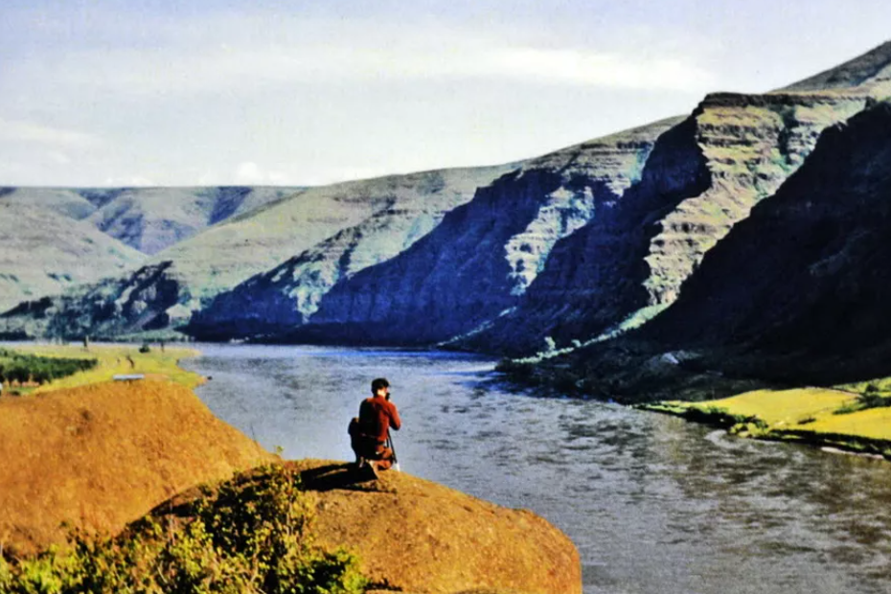

Slide 63
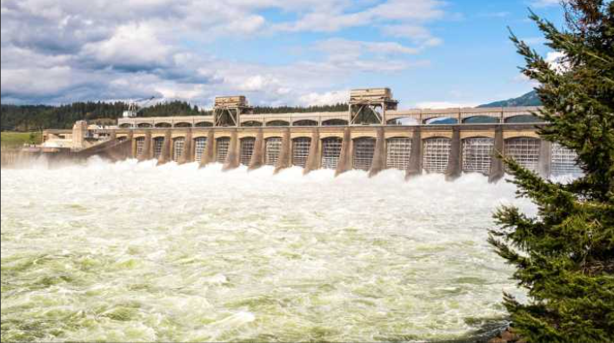
Transmission for 150 GW in some phase of study;
In the phase of Design group considering what is most efficient andcost effective: reconductoring, reconfiguring, high efficiency transmission products
Making most efficient use of current corridors—including under-utilized existing corridors
and right of way whenever possible

Slide 64
E-grid projects Generation Interconnection Reform
BPA completed its 2023 Cluster Study—14 projects emerged
Currently in phase of permitting and design
Generation Interconnection Reform
KREBC transmission collaborative—Montana’s own Robyn Arnold spear-heading this;

Slide 65
Bonneville Power Administration
PUC-PSC Annual Meeting
Portland, Oregon January 11, 2024

Slide 67
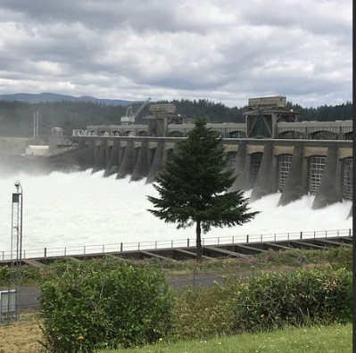

Slide 77
THE IMPACT on FISH HABITAT is the NUMBER ONE concern
Notes:
According to the DOE hydropower primer..READ..Dams block fish from moving along their natural pathways between feeding and spawning grounds, causing interruptions in their life cycles that limit their abilities to reproduce.

Slide 78
“Lower Granite Dam’s retrofitted fish passage technology…and… counting fish returns…It’s no wonder Lower Granite Dam has hit 98% fish passage.”
Notes:
Quote by staffer of Montana U.S. Rep. Cathy McMorris Rogers

Slide 79
Delving into the dams
Federal legislative tour shows staffers how critical lower Snake River dams are to the region
October 2023 issue of Wheat Life
Lower Snake River Dam System Educational Tour August 23, 2023

