Slide 1
68th Legislature 2023
213 Education-related Bills Heard
109 Education-related Bills Passed

Slide 2
HB 117 Generally revise working retiree laws under TRS
This bill revised Retirees laws under TRS, allowing more earnings if they keep teaching (up to 49% from 33%) and allows a retiring teacher to return to teaching after 120 days instead of 150 days.

Slide 3
HB 203 Enhance Educational Opportunities
“Open Enrollment Bill” requires District of Residence to pay Tuition to the receiving district and requires schools to accept out-of-district students with a few exceptions.
Effective July 2024 - next school year
Ramifications for small rural districts - Upper West Shore-Dayton and Valley View (7th and 8th graders); Swan Lake-Salmon Prairie Elementary
Existing law of H.S. sibling with younger siblings

Slide 4
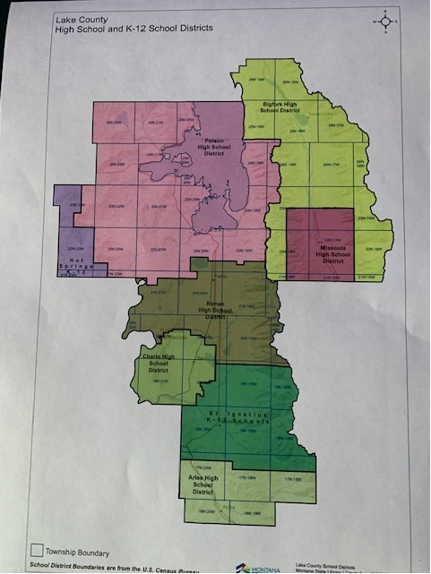
HS Dists. map

Slide 5
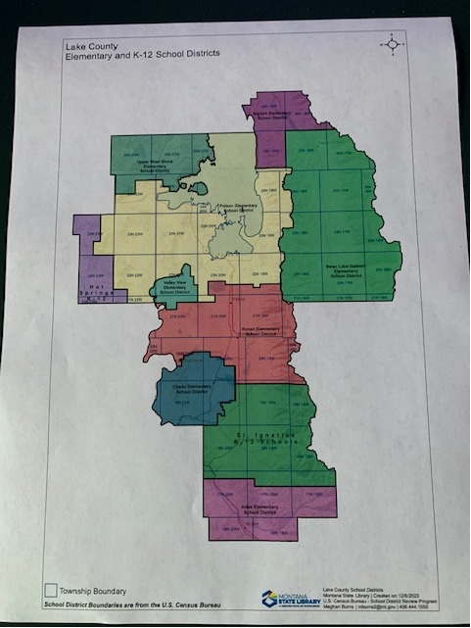
Elementary Dists. Map

Slide 6
HB 214 Remote Instruction Revision for Ed Opportunities
A student may enroll in an online class in a neighboring district if their District does not offer the course.
The District offering the course may receive Part-time ANB for the student in the required increments i.e. 2 or more hours

Slide 7
HB 338 Revision of IEFA laws
New reporting requirements for all districts regarding how IEFA resources are created and how their allocation is spent.
Was retroactive to last school year and required District Clerks to Code and Recode funds, and then correct Trustees Financial Summaries for last year’s funding, before December 10, 2023.

Slide 8
HB 352 Targeted Interventions to Support 3rd Grade Reading Proficiency
Funding for a 4 year old reading intervention program.
Funding for Summer School Pre-K, K, 1, 2, 3 grades for those in need of intervention
Effective July 2024

Slide 9
HB 359 Prohibit minors from attending drag shows
Prohibits sexually-oriented performances on school premises during the school day or as part of extra-curricular activities
Prohibits any simulation of sexual activity, stripping, salacious dancing, any lewd or lascivious depiction or description of human genitals roof sexual conduct as defined in 45-5-625
Penalties: csLoss of license and fines

Slide 10
HB 361 Use of a Name and Sex by a student is not Discrimination
Schools cannot discipline for misgendering or use of “dead” name, if the behavior does not rise to the definition of bullying (20-5-208)
It is not unlawful discriminatory practice for a student to: a. Call another student by the student’s legal name or b. Refer to another student by the student’s sex

Slide 11
HB 393 Students with Special Needs Equal Opportunity Act
Establishes a special education savings account. (Legal challenge is underway - violates MT Constitution, privatization with public funds.
Administered by the Supt of Public Instruction
Student cannot be enrolled in public school. Family receives ANB funding to use towards variety of private or non-oybkuc school services.
Families waive right to FAPE and school dist. not on the hook for IEP management nor services.

Slide 12
HB 396 Requires Admittance of Resident children on Part-time Basis
Schools must allow part-time enrollment for any students that are residents of the school district, when student is enrolled in a non-public or home school.
Part-time student must enroll for at least enough time to meet ANB requirements as part -time status
District still has the authority to determine placement (both location and program)

Slide 13
HB 450 Protects Physical Self-defense in K-12 schools
“AKA Punch a bully in the nose” bill
Schools cannot discipline a student who uses physical force that is reasonable and necessary for self-protection.
Also can use reasonable and necessary physical restraint in protection of another who is being physically attacked.
Only impacts school code, not criminal code.

Slide 14
HB 504 Revision requiring Trustees to Adopt a Grievance Policy
Requires schools to have a grievance policy/procedure that accepts filing of a formal complaint within 30 days of the completion of the informal resolution.

Slide 15
HB 676 Revise laws to clarify Fundamental Parental Rights
Establishes parent rights, the vast majority are already protected in state or federal law.
One exception: To be notified promptly if, and provide consent, before, the child would share a room or sleeping quarters with an individual of the opposite sex on a school-sponsored trip.
See next slide for clarification

Slide 16
MCA 40-6-707
Montana Code Annotated 2023
TITLE 40. FAMILY LAW
CHAPTER 6. PARENT AND CHILD
Part 7. Rights of Parents
Construction
40-6-707. Construction. (1) Unless a right has been legally waived or legally terminated, a parent has inalienable rights that are more comprehensive than those listed in 40-6-701, 40-6-702, 41-1-402, 41-1-403, 41-1-405, and this section. The protections afforded by 40-6-701, [section 2], 41-1-402, 41-1-403, 41-1-405, and this section are in addition to the protections provided by the constitutions of the United States and the state of Montana and by federal and state law.
(2) Sections 40-6-701, 40-6-702, 41-1-402, 41-1-403, 41-1-405, and this section must be construed in favor of a broad protection of the fundamental right of parents to direct the upbringing, education, health care, and mental health of their child.
(3) Sections 40-6-701, 40-6-702, 41-1-402, 41-1-403, 41-1-405, and this section may not be construed to authorize any government entity to burden the fundamental right of parents to direct the upbringing, education, health care, and mental health of their child.
(4) If a child has no affirmative right of access to a particular medical or mental health procedure or service, then nothing in 40-6-701, 40-6-702, 41-1-402, 41-1-403, 41-1-405, and this section may be construed to grant the child's parent an affirmative right of access to the procedure or service on the child's behalf.

Slide 17
Charter Schools
HB 549 - Public Charter School - Creates option governed by local school board OR Board of Public Ed if local declines. Provides for funding (additional basic entitlement) for approved charter schools or programs over certain enrollments.
HB 562 - Community Choice Schools - Creates option for private charter schools with approval a Charter chool Commission (Legal challenge underway) Charter would receive ANB and basic entitlement, but no accountability. Exempt from all MCA school codes in Section 20.

Slide 18
HB 715 School Immunization Laws
Changes school immunization procedures. Communication from the school regarding immunization requirements must include info about exemptions allowed in state law, including a copy or link to exemption forms.
Also removes requirement for “notarized” signature for religious exemption. Parent can just submit signed affidavit.

Slide 19
HB 724 Public Notice Requirements
Publish meeting agendas on website or social media
Newspapers not required unless the newspaper provides a free option.

Slide 20
Religious Expression
HB 744 - Allows students and teachers to initiate or participate in conversations about religion, beliefs, or practices with another student or teacher.
HB 745 - A student is allowed to read from the Bible or other religious materials during free reading time. If reading reqs. is part of the course and students are allowed to self-select, they must be allowed to read from Bible or other religious materials. Prayer is permitted in school, school grounds, or at a school-sponsored event, but a person may not be compelled to pray.
School day may begin with a prayer.

Slide 21
HB 811- Repository of School Trustee Information
OPI will create and maintain a repository of information regarding school district trustees
Terms of office, contact information, websites

Slide 22
SB 8 - Revises Transformational Learning Program Laws
Defines proficiency based learning: an education system in which student progress is based on a student’s demonstration of competency rather than on the basis of seat time or the age or grade level of the student.
This definition will be used with Transformational Learning grants.

Slide 23
SB 213 - School Safety Teams
Requires implementation of threat assessment practices as part of school safety plan.
Requires threat assessment protocol and threat assessment team.
Strengthens language for establishment of County Interdisciplinary Team.

Slide 24
SB 518 - Parental Rights to Increase Parental Involvement in Education
Details requirements for parent involvement policy - most of which is already allowed or done.
Exceptions: Procedures by which parent may learn about nature and purpose of clubs and activities AND student shall provide signed parent permission form PRIOR to participating in any school-sponsored club or extracurricular activity.
Procedure for parent written consent before child uses a pronoun that does not align with child’s sex & can’t compel staff or other students to use that pronoun, even with Parent consent.

